Slide 1

PSG Institute Of Technology and Applied Research
Neelambur,Coimbatore
Department of Electronics and Communication Engineering
INTELLIGENT PARKING FOR ADAS
Project Viva-voce
05/08/2021

Slide 2
PROJECT GUIDE
Dr. G. SANTHANAMARI.ASSO PROF/DEPT OF ECE/PSGITECH
TEAM MEMBERS
MANOJ KUMAR.S (715517106023)
RAHESH.R (715517106033)
ANTHONY PAL CLINTAN.A (715517106302)
05/08/2021

Slide 3
OVERVIEW
ABSTRACT
MOTIVATION
LITERATURE SURVEY
PROPOSED WORK
PROCESS FLOW
WORK DONE
RESULTS
CONCLUSION
FUTURE WORK
REFERENCES
PUBLICATION
05/08/2021

Slide 4
ABSTRACT
Urban centers and dense population are expanding hence drivers find it difficult to find suitable parking slot in shopping malls, hospital etc.,
This increases vehicular exhausts and creates a negative impact on the environment.
An intelligent parking system is developed based on BLE and makes use of multilateration approach to increase accuracy.
05/08/2021

Slide 5
MOTIVATION
In shopping malls and hospitals, due to enormous number of vehicles and manual parking system people face difficulties in finding the parking spot and it consumes more time
Drivers find difficulties in Parking the vehicle when there is more number of parked vehicles and the driver should concern not to damage any other vehicles and arrive at correct spot
05/08/2021

Slide 6
LITERATURE SURVEY
NO | JOURNAL TITLE | REFERENCE PAPER | Author | INFERENCE
1. | IEEE Access | Integrity Monitoring for Bluetooth Low Energy Beacons RSSI Based Indoor Positioning( 2020) | HAIYUN YAO , HONG SHU ,XINLIAN LIANG , (Senior Member, IEEE), HONGJI YAN , AND HONGXING SUN | RSSI value of Bluetooth beacon is calculated at different lengths. Geometry of Network affects Performance
2. | IEEE Systems Journal | Smart Parking System Based on Bluetooth Low Energy Beacons with Particle filtering(2020) | Andrew Mackey, Student Member, IEEE, Petros Spachos , Senior Member, IEEE, and Konstantinos N. Plataniotis, Fellow, IEEE | Individual BLE beacons is used in each slot for parking management. Therefore overall cost increases
3. | IEEE Global Conference on Signal and Information Processing (GlobalSIP) | Performance Evaluation of Beacons for Indoor Localization in Smart Buildings(2017) | A. Mackey and P. Spachos | Performance of Different Bluetooth beacons is evaluated. Metals and concrete might block beacon signals
05/08/2021

Slide 7
NO | JOURNAL TITLE | REFERENCE PAPER | Author | INFERENCE
4. | IEEE 7th Annual Computing and Communication Workshop and Conference (CCWC) | Comparison of energy consumption in Wi-Fi and bluetooth communication in a Smart Building(2017) | G. D. Putra, A. R. Pratama, A. Lazovik, and M. Aiello | Bluetooth is 30% more energy efficient than Wi-Fi. Interference may disturb the connection if multiple Bluetooth devices are running simultaneously
5. | International Conference on Soft Computing, Intelligent System and Information Technology (ICSIIT) | Development of Mobile Indoor Positioning System Application Using Android and Bluetooth Low Energy with Trilateration Method (2017) | Agustinus Noertjahyana, Ignatius Alex Wijayanto, Justinus Andjarwirawan | Location is calculated by trilateration method. Therefore hidden node problem may occur.
05/08/2021

Slide 8
PROPOSED WORK
In this work, BLE(Bluetooth Low Energy) Beacons are used to track location of the vehicle and send the live location of nearby available free parking slot to the driver
An IOT server stores the information of available spots and the android mobile application shows the live location of available free slot
In this system only 4 BLE beacons are required to provide the live location of the driver.
05/08/2021

Slide 9
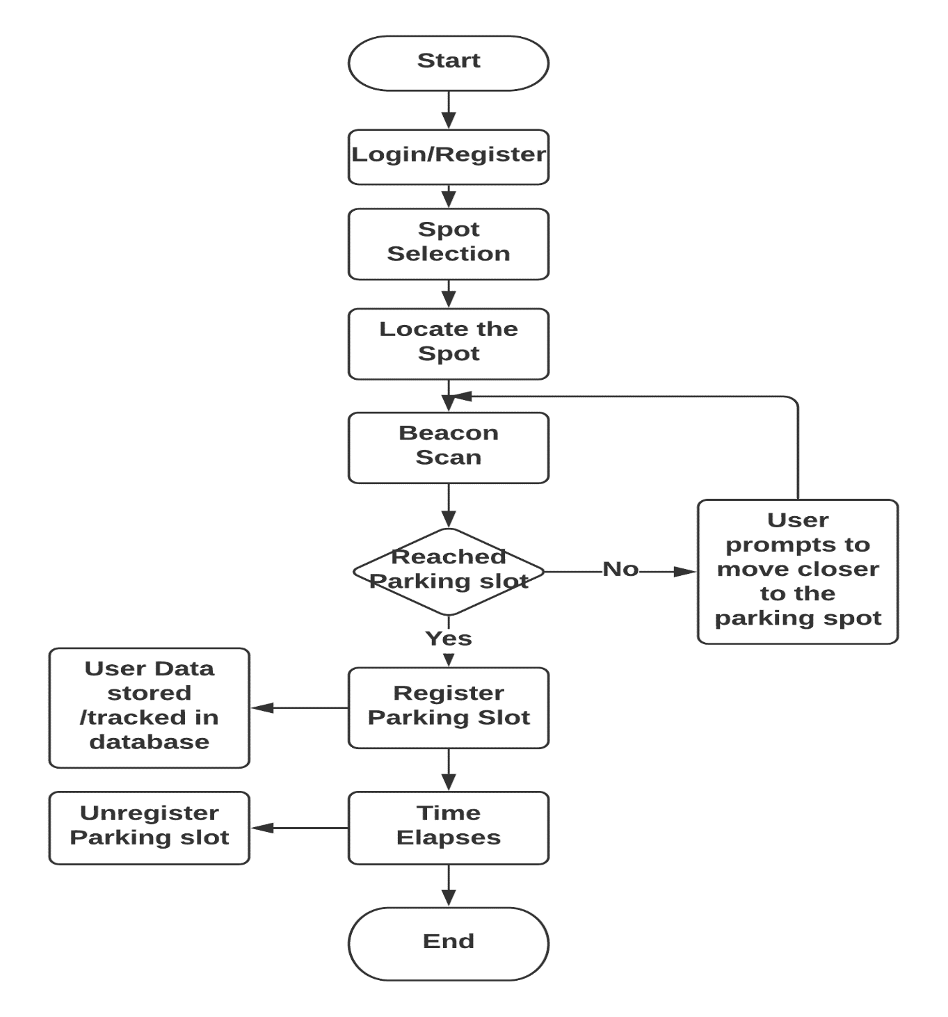
PROCESS FLOW
05/08/2021

Slide 10
WORK DONE
An Android Application ‘BLE scan’ was created. This app scans the Bluetooth devices available nearby, it keeps track of Bluetooth ID and RSSI values.
An Android application ‘Parking App’ was developed and users can book their parking slot and view the live location using the data collected from the BLE beacons.
05/08/2021

Slide 11
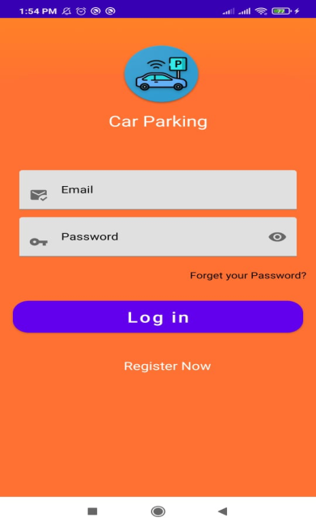
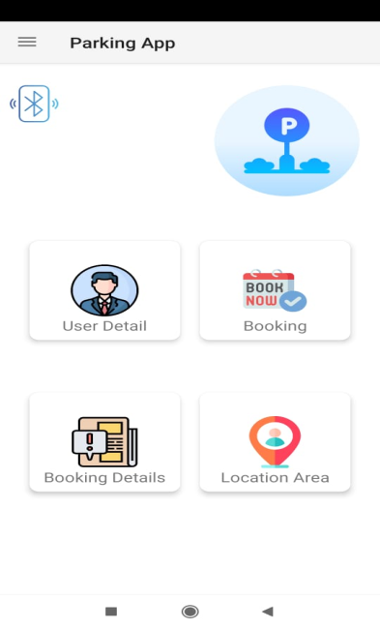
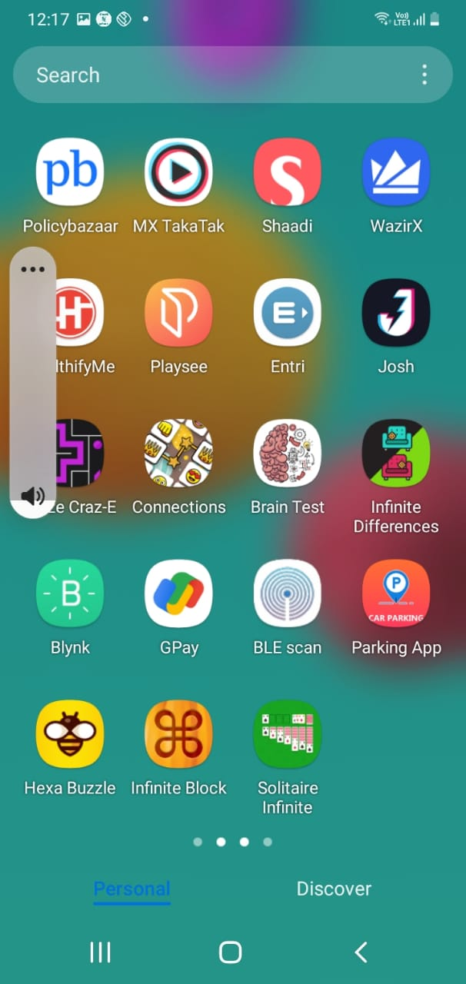
RESULTS
Logo of the Parking App
Register Page
Home Page
05/08/2021

Slide 12
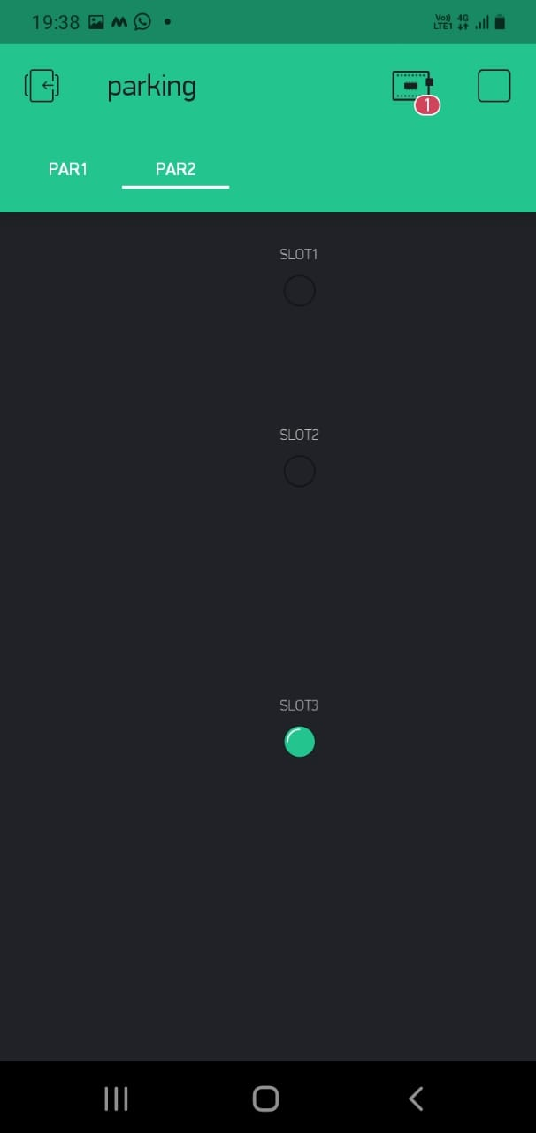
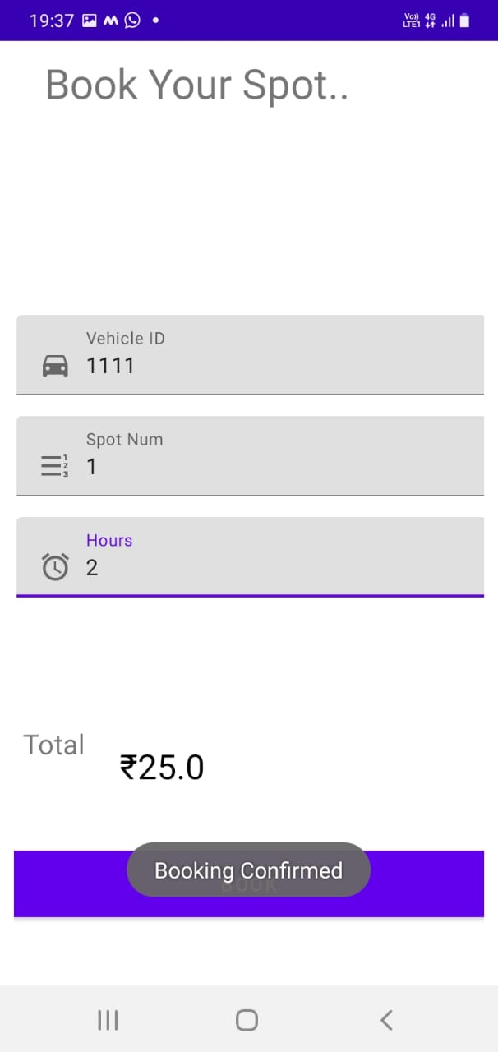
Parking Slot Indicator
Booking slot
05/08/2021

Slide 13
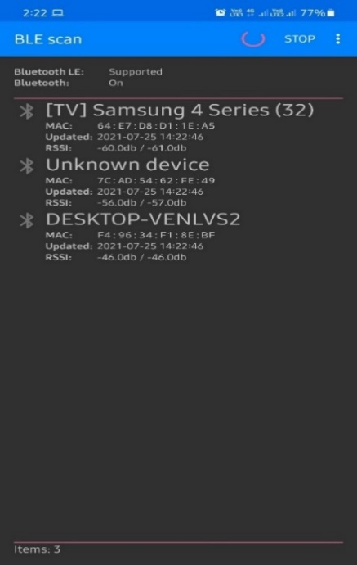
BLE Scan
BLE Scan application scans the nearby Bluetooth devices and stores their information when scanning starts. It stores all the details about the scanned devices, such as the name of the device, last scanned RSSI value of the device, MAC address of device, time of scanning.
05/08/2021

Slide 14
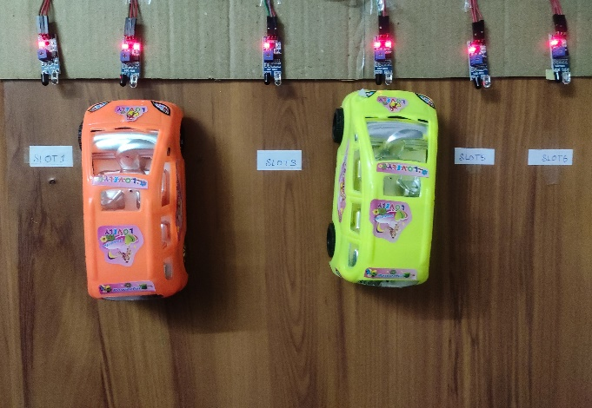
EXPERIMENTAL SETUP
We have used a demo parking area wherein 6 parking slots are available sideways which is shown below. Here slot 2 and slot 4 are occupied, whereas remaining slots are not occupied
Experimental setup
05/08/2021

Slide 15
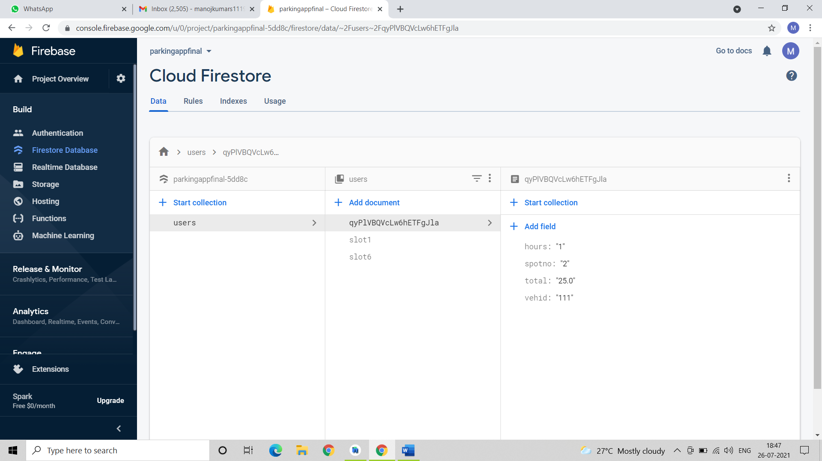
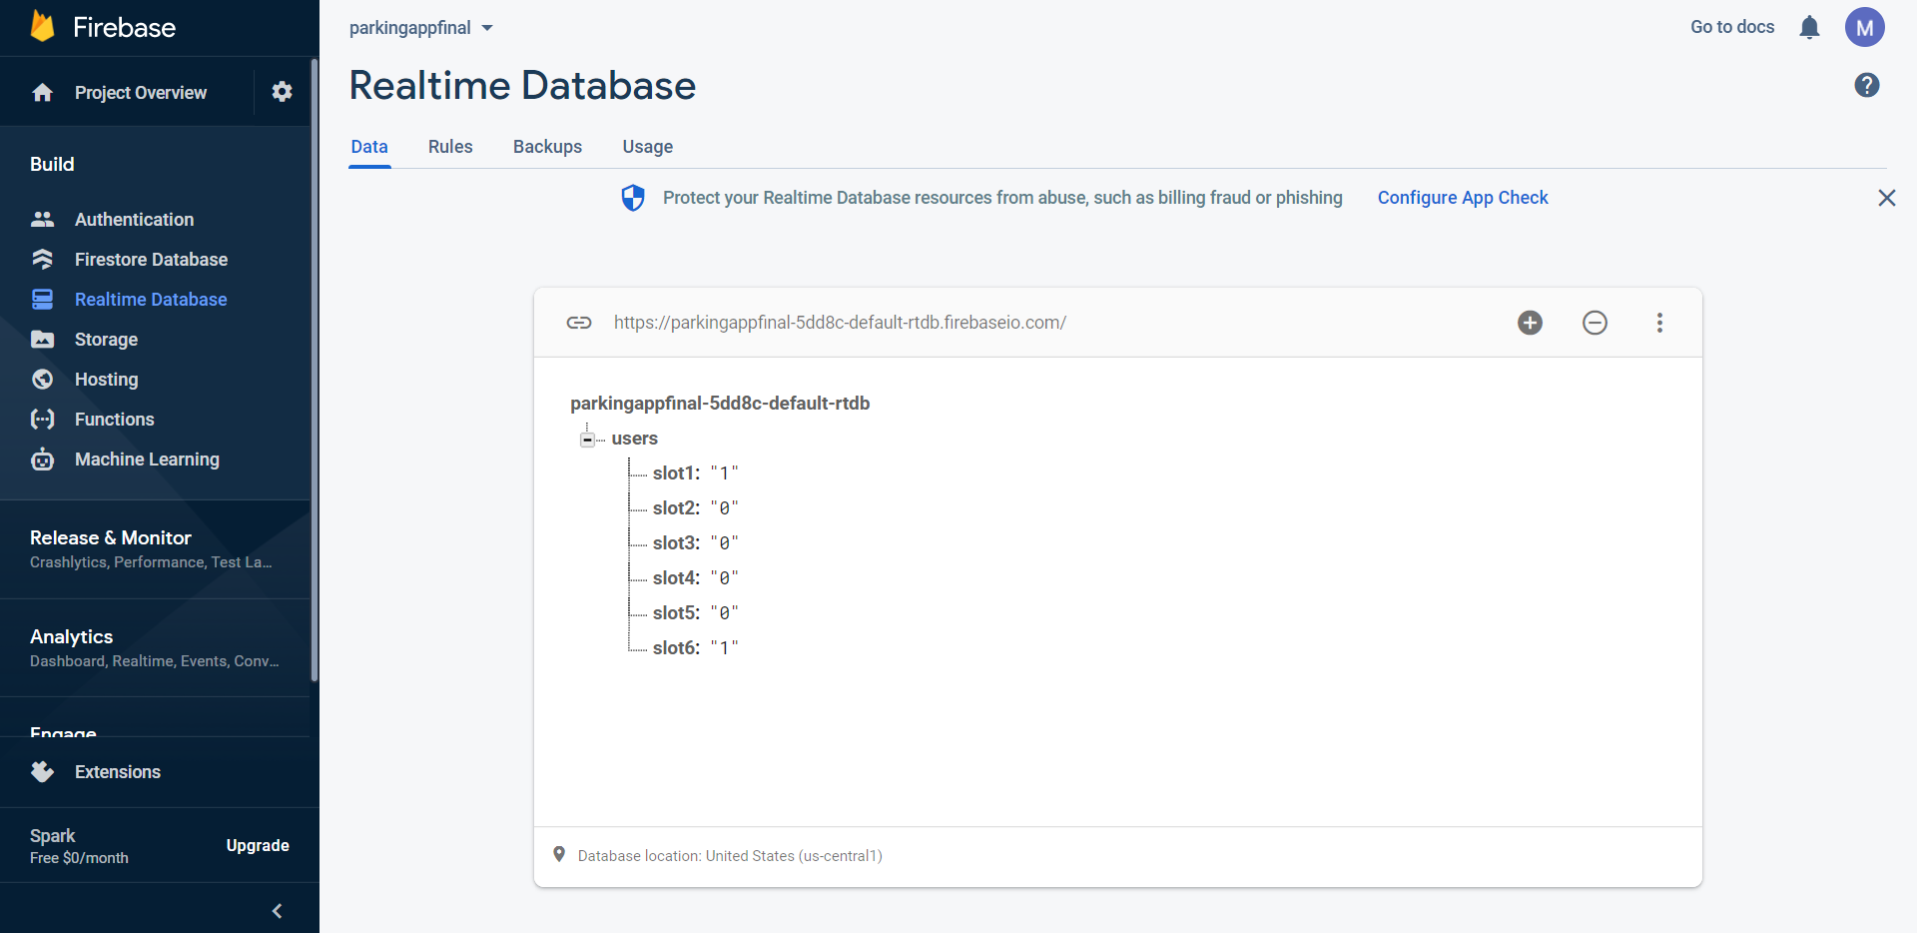
FIREBASE
Data stored in cloud Firestore
Data stored in Realtime Database
05/08/2021

Slide 16
CONCLUSION
Outdoor navigation systems, like google maps uses GPS for positioning and navigation. GPS doesn’t work in indoors so it couldn’t be preferable.
We have used the RSSI parameter and followed the multilateration technique for positioning and navigation. An application is developed, as a whole outcome of the system. The application interacts with the hardware and performs further calculations on the basis of the inputs taken from the BLE Beacons.
05/08/2021

Slide 17
FUTURE WORK
Integrating localization processing capabilities and using filtering techniques to reduce errors and increase accuracy.
Using Time of Flight (ToF) & Angle of Arrival (AoA) measurement method-based (BLE) positioning system. This can be achieved by using antennas or an antenna grid.
Deploying hybrid solution with BLE devices (i.e., iBeacon) and other infrastructure nodes (like Wi-Fi etc.). Using machine learning and data fusion algorithms to ease deployment, expansion of already existing system.
05/08/2021

Slide 18
REFERENCES
Andrew Mackey, Petros Spachos and Konstantinos N. Plataniotis “Smart Parking System Based on Bluetooth Low Energy Beacons With Particle Filtering” on IEEE system Journal,2020
Haiyun Yao, Hong shu, Xinlian Liang, Hongji Yan AND Hongxing Sun “Integrity Monitoring for Bluetooth Low Energy Beacons RSSI Based Indoor Positioning” on IEEE Access 2020
A. Mackey and P. Spachos “Performance Evaluation of Beacons for Indoor Localization in Smart Buildings” on IEEE Global Conference on Signal and Information Processing (GlobalSIP) 2017
G. D. Putra, A. R. Pratama, A. Lazovik, and M. Aiello “Comparison of energy consumption in Wi-Fi and bluetooth communication in a Smart Building” on IEEE 7th Annual Computing and Communication Workshop and Conference (CCWC) 2017
Agustinus Noertjahyana, Ignatius Alex Wijayanto, Justinus Andjarwirawan “Development of Mobile Indoor Positioning System Application Using Android and Bluetooth Low Energy with Trilateration Method” on International Conference on Soft Computing, Intelligent System and Information Technology (ICSIIT) 2017
Android beacon library. [Online]. Available: https://altbeacon.github.io/ android-beacon-library/index.html
05/08/2021

Slide 19
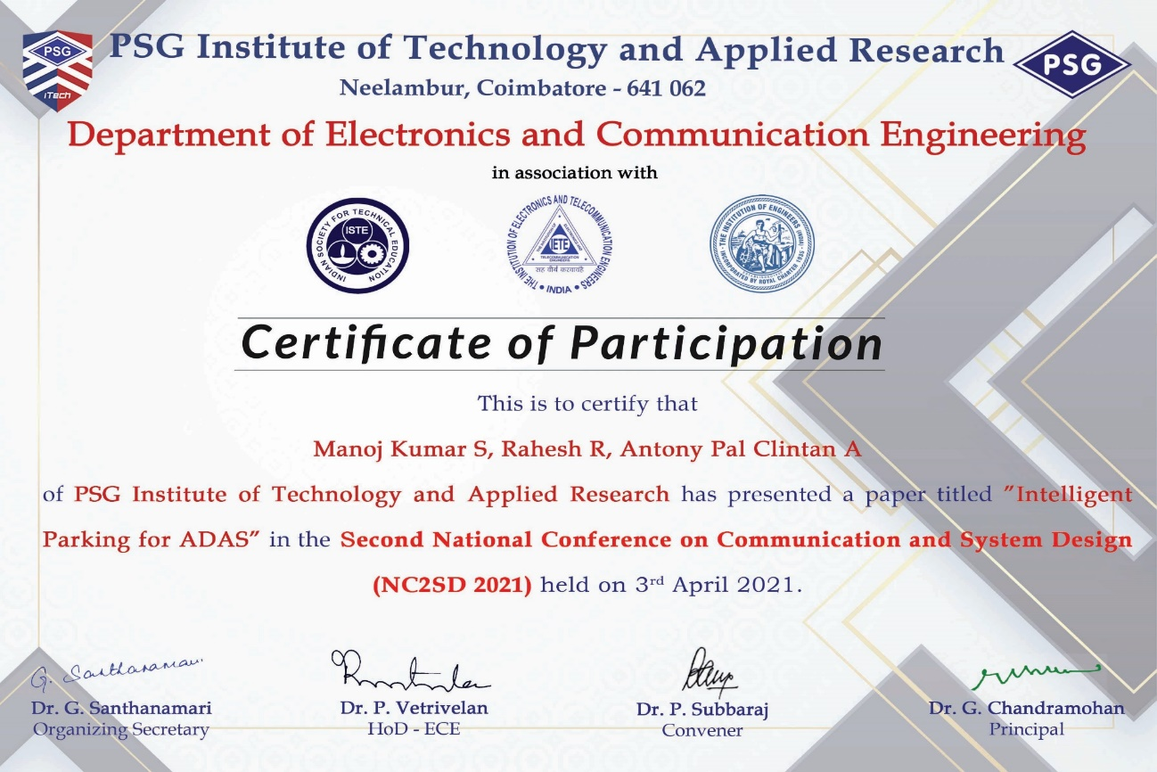
PUBLICATION
Manoj Kumar S, Rahesh R, Anthony Pal Clintan A “Intelligent Parking for ADAS” on Second National Conference on Communication and System Design (NC2SD), 2021.
05/08/2021

Slide 20
THANK YOU
05/08/2021

